Slide 1

Systems Analysis & Design
K Anuradha
BSc (Hons) in Information Technology (KDU)
Masters in Information Systems Management (UOC)

Slide 2
Planning Phase

Slide 3
Project Selection and Management
Notes:
Self Introduction of my self –
Give students some general guidelines – about KDU, their choice

Slide 4
Outline
Project selection.
Creating the project plan.
Managing and controlling the project.

Slide 5
INTRODUCTION
CIOs (chief information officers) are challenged to select projects that will provide highest return on the IT investments.
Project portfolio management has become a critical success factor for IT departments.
A selected system development project must undergo a thorough process of project management.
A critical success factor for project management is to start with a realistic assessment of the work and then manage the project according to the plan.
Notes:
A Chief Information Officer (CIO) is a high-level executive within an organization who is responsible for overseeing the management and strategic use of information technology (IT) and information systems. The CIO plays a critical role in aligning IT strategies and initiatives with the overall business objectives of the organization.
Project portfolio management (PPM) is a strategic approach to managing an organization's projects, programs, and initiatives. It involves the selection, prioritization, monitoring, and optimization of a group of projects and programs to achieve specific strategic objectives and maximize overall value for the organization. PPM is particularly important for organizations that have a large number of projects and limited resources, as it helps ensure that resources are allocated to the right projects in the right way to achieve the organization's goals.

Slide 6
(cont’d)
steps
  Select correct development methodology
  Estimate the time (based on size)
  List out all steps
  What staff need ?
  Assign works and place mechanism to coordinate the team members
  Monitor the project
  Refine estimates as work progress

Slide 7
(cont’d)
Organizational Perspective
  Balance between cost and benefits
  Trade-off
  % of high risk projects out of all projects ?
Why projects rejected
  No money
  Planned organizational change
  Same project underway
  Does not align with company strategy
Notes:
Organizations use cost-benefit analysis to evaluate the potential return on investment (ROI) for each project within the portfolio. This analysis assesses both the expected costs associated with a project (such as labor, materials, and technology) and the expected benefits (such as increased revenue, cost savings, or strategic alignment). Projects that offer a favorable cost-benefit ratio are generally prioritized.
resource Allocation: PPM involves allocating resources, including budget, time, and personnel, to projects within the portfolio. The allocation process should consider not only the expected benefits of each project but also the available resources and the organization's capacity to execute multiple projects simultaneously.
Risk Assessment: While considering the balance between cost and benefits, organizations also need to assess the risks associated with each project. High-risk projects may require additional resources, mitigation strategies, or contingency plans to manage potential challenges. Organizations often weigh the potential benefits against the level of risk to determine if a project is worth pursuing.
Trade-offs: In PPM, trade-offs are common when trying to strike the right balance between cost and benefits. This may involve making decisions such as delaying certain projects, reducing project scope, or reassigning resources to higher-priority initiatives. Trade-offs are necessary to ensure that the organization maximizes its return on investment and aligns with its strategic objectives.

Slide 8
PROJECT SELECTION
Systems projects today are evaluated in the context of an entire portfolio of projects.
Determination of a project’s contribution to an entire portfolio of a project reinforces the need for a feasibility study.
Portfolio management takes into consideration the different of projects that exist in an organization.

Slide 9
(cont’d)
An approval committee must be selective about where to allocate resources as most organizations have limited funds.
If there are several potentially high-payoff projects, and they all have the same risk, then maybe only one of the projects will be selected.

Slide 10
QUESTION ?
How CIO select project ?
  Entire portfolio
  Resource
  Risk levels
Notes:
Chief Information Officers (CIOs) play a critical role in selecting and prioritizing projects within their organization's portfolio. The selection process typically involves considering various factors, including the entire portfolio, available resources, and risk levels. Here's a breakdown of how CIOs make project selection decisions based on these factors:
Alignment with Business Goals: CIOs start by aligning project selection with the organization's broader business goals and strategic objectives. Projects should directly contribute to the achievement of these goals. This ensures that technology investments are in sync with the overall direction of the company.
Portfolio Assessment: CIOs conduct a comprehensive assessment of the entire project portfolio. This assessment involves reviewing the existing projects, their status, and their contributions to the organization. It helps identify redundancies, dependencies, and opportunities for optimization.
Resource Availability: CIOs evaluate the availability of resources, including budget, personnel, and technology infrastructure. They need to ensure that the organization has the capacity to execute the selected projects effectively. Resource constraints can influence the decision to greenlight or delay certain initiatives.
Risk Evaluation: CIOs assess the risk levels associated with each project. This evaluation includes considering the technical, operational, financial, and strategic risks that a project may pose. High-risk projects may require additional planning, mitigation strategies, or executive oversight.
Cost-Benefit Analysis: CIOs conduct cost-benefit analyses for each potential project. This analysis helps quantify the expected costs and benefits of each initiative. Projects with a favorable cost-benefit ratio are given higher priority.
ROI and Value Proposition: CIOs prioritize projects that offer the highest return on investment (ROI) and align with the organization's value proposition. They consider not only financial returns but also intangible benefits, such as improved customer satisfaction or market competitiveness.
Strategic Importance: CIOs prioritize projects that are strategically important to the organization. These may include initiatives that enable digital transformation, enhance cybersecurity, or support critical business processes.
Stakeholder Input: CIOs gather input from key stakeholders, including business units, department heads, and other executives. Input from these stakeholders helps ensure that project selection decisions are well-informed and align with the needs and priorities of different parts of the organization.
Portfolio Balancing: CIOs aim to create a balanced portfolio that includes a mix of short-term and long-term projects, as well as projects that address various business needs. This balance helps mitigate risks and ensures that the organization is not overly focused on one area at the expense of others.
Regular Review and Adjustments: Project selection is an ongoing process. CIOs regularly review the portfolio, reassess project priorities, and make adjustments as needed based on changing business conditions, resource availability, and strategic shifts.

Slide 11
CREATING THE PROJECT PLAN
Project management phases consist of
- Initiation
- Planning
- Execution
- Control
- Enclosure.

Slide 12
Project Methodology Options
A methodology is a formalized approach to implementing the SDLC.
- Waterfall Development
- Parallel Development
- V-model (variation of the Waterfall Development)
- Rapid Application Development (RAD)
- Iterative Development
- System prototyping
- Agile Development

Slide 13
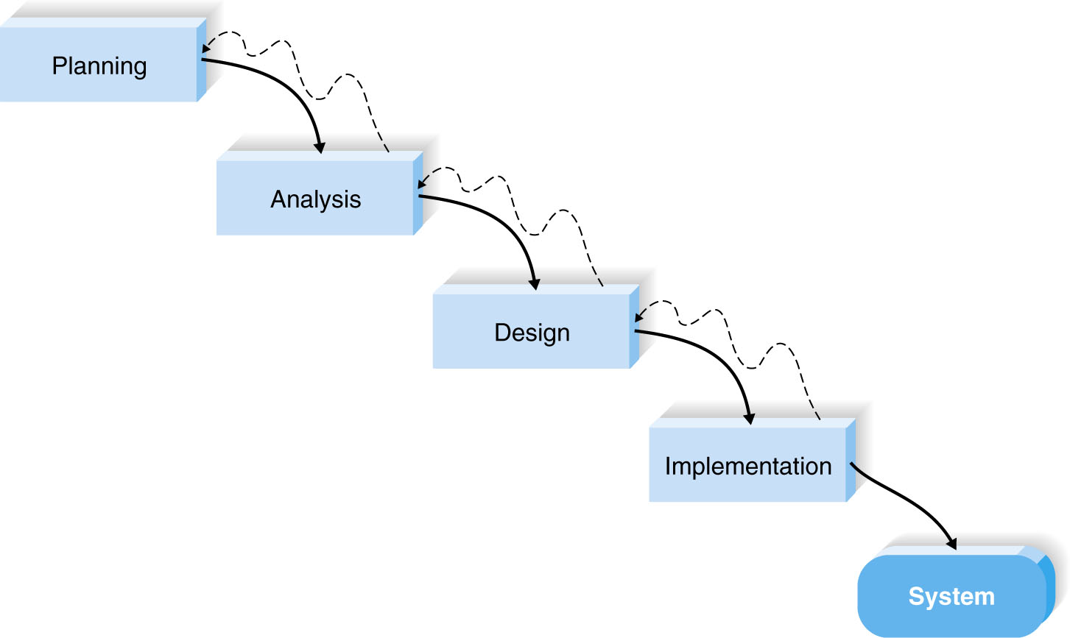
Waterfall Development
Notes:
Waterfall development methodologies have the advantages of identifying requirements long before programming begins and limiting changes to the requirements as the project proceeds.
Disad
design must be completely specified before programming begins,

Slide 14
List advantages and disadvantages.

Slide 15
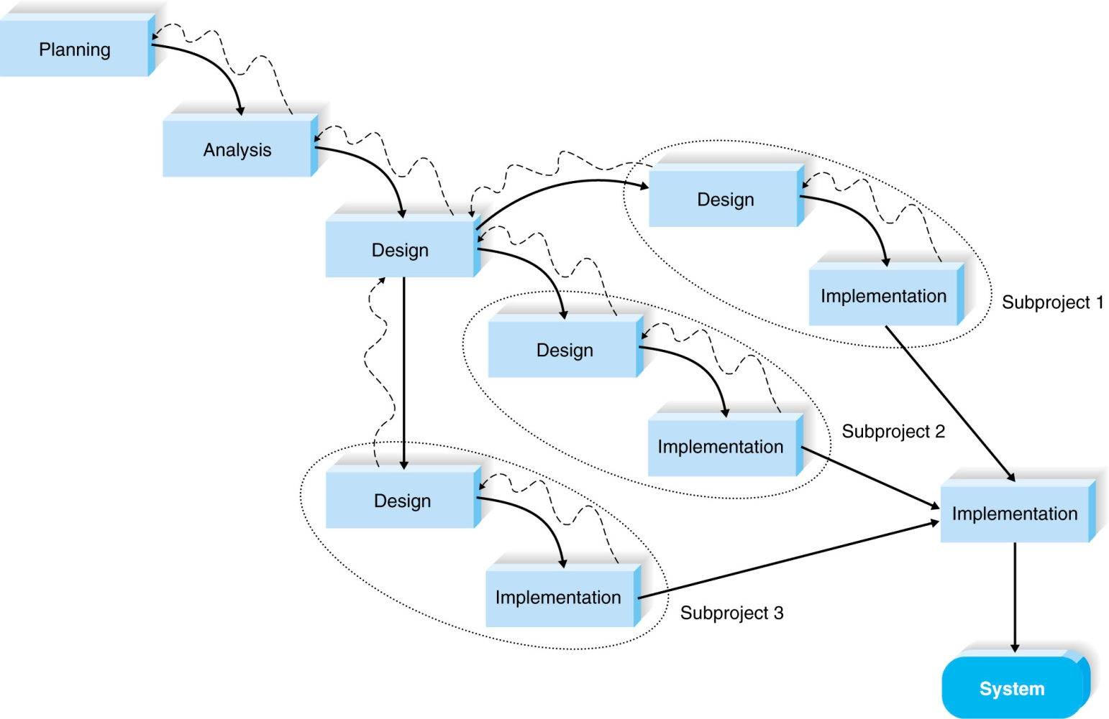
Parallel Development
Notes:
This is a variant of waterfall approach..
instead of doing the design and implementation in sequence, a general design for the whole system is performed. Then the project is divided into a series of subprojects that can be designed and implemented in parallel.
Ad
reduces the time required to deliver a system,
Disad
If the subprojects are not completely independent, design decisions in one subproject may affect another, and at the project end, integrating the subprojects may be quite challenging.

Slide 16
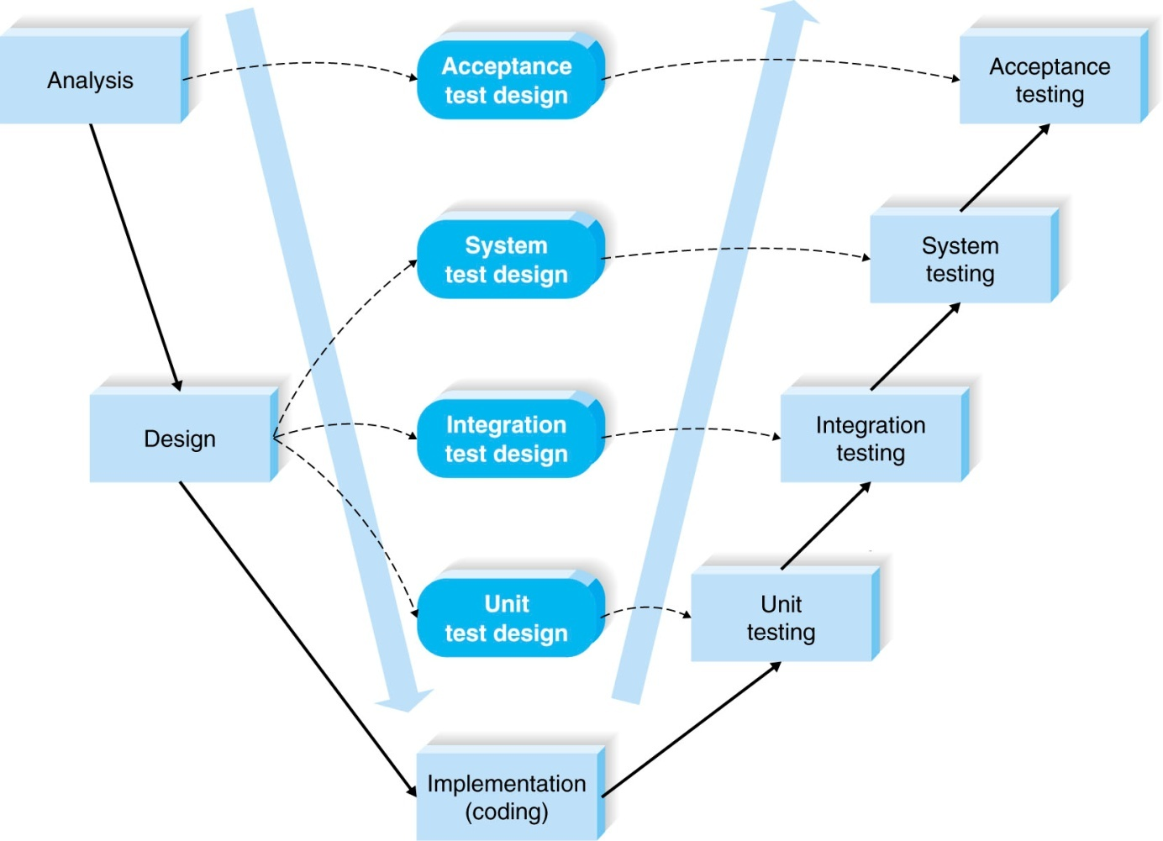
V-model
Notes:
The V-model is another variation of waterfall development that pays more explicit attention to testing.
A key concept of this model is that as requirements are specified and components designed, testing for those elements is also defined.
In this manner, each level of testing is clearly linked to a part of the analysis or design phase, helping to ensure high quality and relevant testing and maximize test effectiveness.

Slide 17
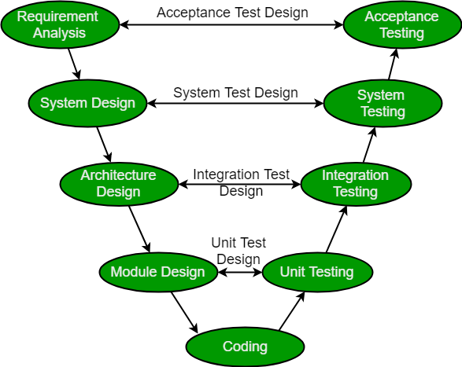
V-model

Slide 18
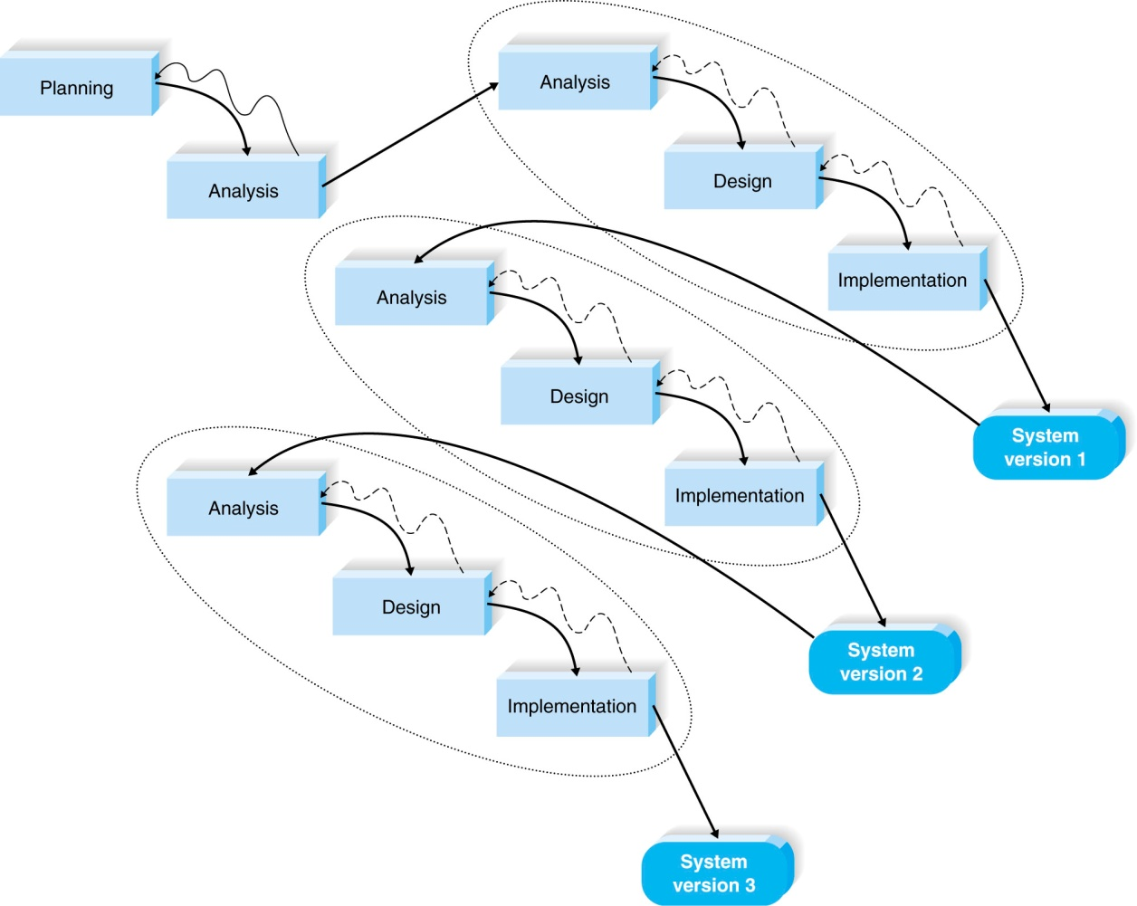
Rapid Application Development: Iterative Development
Notes:
Rapid application development is a collection of methodologies that emerged in response to the weaknesses of waterfall development and its variations.
RAD incorporates special techniques and computer tools to speed up the analysis, design, and implementation phases in order to get some portion of the system developed quickly and into the hands of the users for evaluation and feedback.
CASE tools -Computer-aided software engineering
JAD
Fourth generation/visual programming languages
Code generators
Iterative development breaks the overall project into a series of versions that are developed sequentially. The most important and fundamental requirements are bundled into the first version of the system. This version is developed quickly by a mini-waterfall process, and once implemented, the users can provide valuable feedback to be incorporated into the next version of the system.

Slide 19
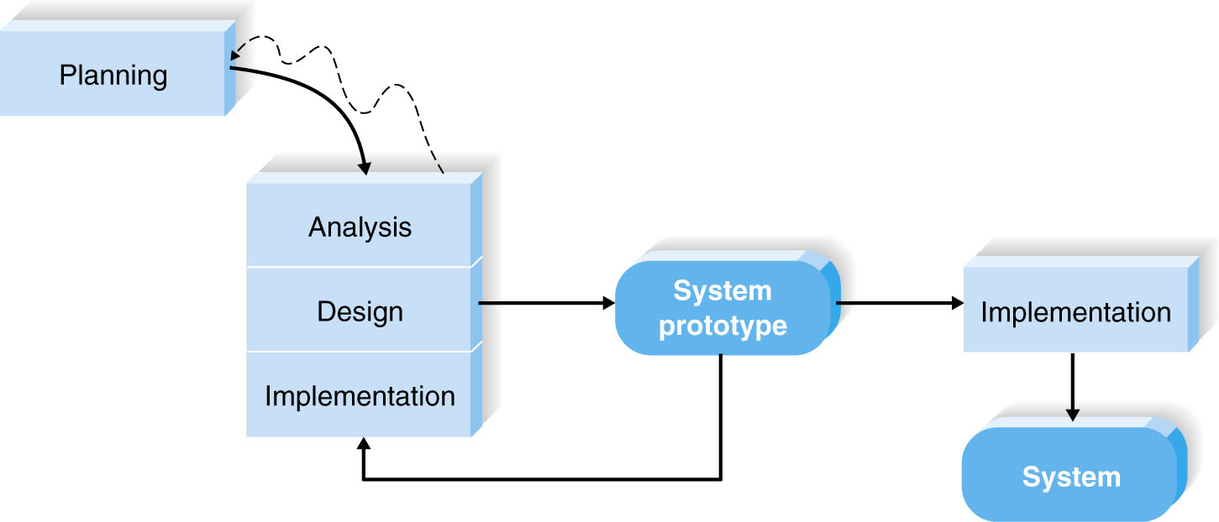
Rapid Application Development:
System Prototyping
Notes:
System prototyping performs the analysis, design, and implementation phases concurrently in order to quickly develop a simplified version of the proposed system
and give it to the users for evaluation and feedback.
What is a prototype - quickly develop a simplified version of the proposed system and give it to the users for evaluation and feedback
System prototyping very quickly provides a system for users to evaluate and reassures users that progress is being made..

Slide 20
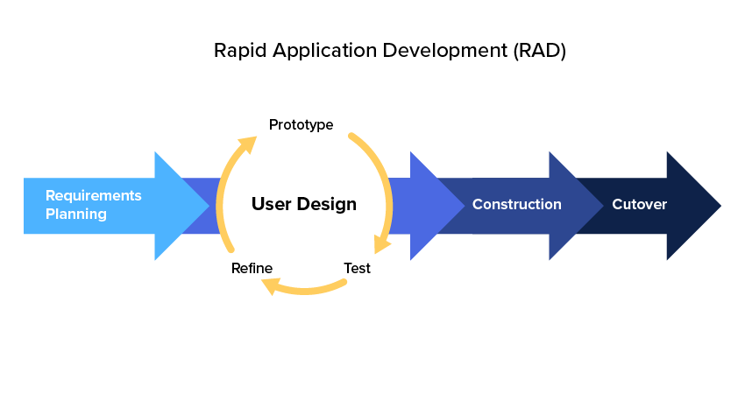

Slide 21
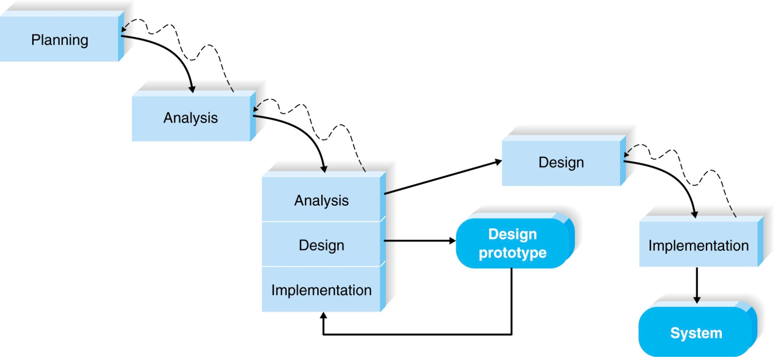
(cont’d)
Throwaway prototyping
Notes:
Throwaway prototyping6 includes the development of prototypes, but uses the prototypes primarily to explore design alternatives rather than as the actual new system
(as in system prototyping).
For example, suppose that users are not completely clear on how an order entry system should work. The analyst team might build a series of HTML pages
to be viewed on a Web browser to help the users visualize such a system.

Slide 23

Agile

Slide 24
Agile Development
A group of programming-centric methodologies that focus on streamlining the SDLC.
Includes face-to-face communication
Extreme programming – emphasizes customer satisfaction and teamwork.

Slide 25
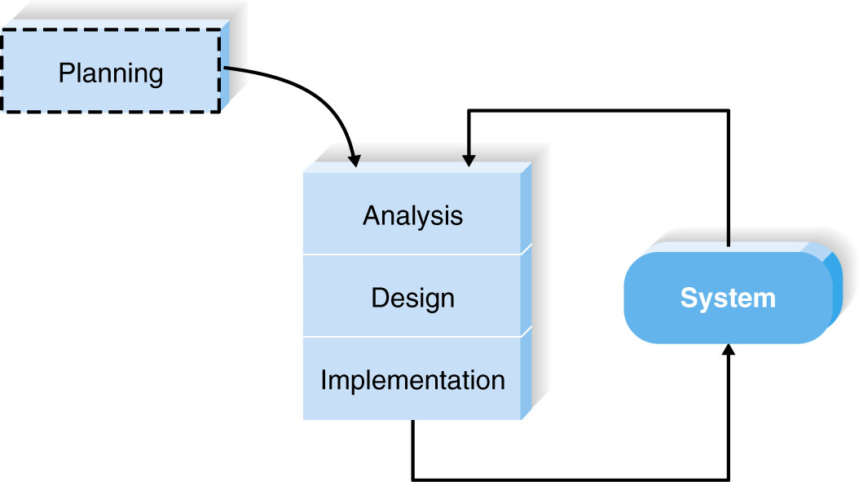
Extreme Programming
Notes:
Extreme programming11 emphasizes customer satisfaction and teamwork.
Communication, simplicity, feedback, and courage are core values. Developers communicate
with customers and fellow programmers. Designs are kept simple and clean.
Early and frequent testing provides feedback, and developers are able to courageously
respond to changing requirements and technology. Project teams are kept small.

Slide 26
Question
What methodology to your project

Slide 27
Research on Agile Development Methodologies.
Question

Slide 28
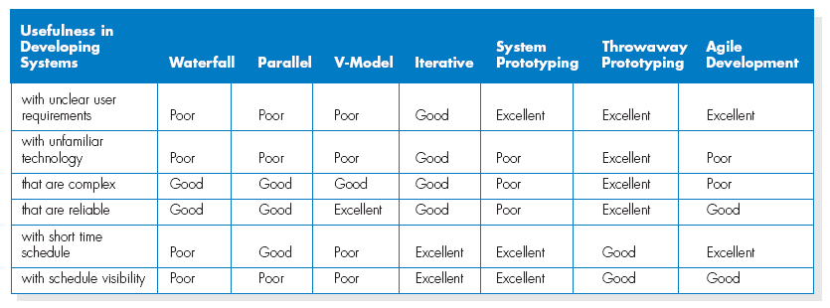
Selecting the Appropriate Development Methodology

Slide 29
(cont’d)
Important factors to consider in selecting the development methodology
- Clarity of User Requirements
- Familiarity with Technology
- System Complexity
- System Reliability
- Short Time Schedules
- Schedule Visibility

Slide 30
Estimating the Project Time Frame
Project Manager’s Primary Task
Project Estimation
Estimation is the process of assigning projected values for time and effort
Project Estimation can be performed manually or with SW.
Numbers for calculations take from different sources
Notes:
Numbers” for calculations take from different sources
- methodology itself, similar projects, personnel exp

Slide 31
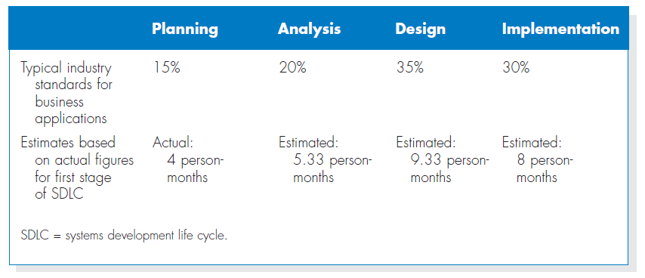
Estimating Project Time

Slide 32
Staffing the project
How many?
What Skill?
Motivation
Minimize conflicts

Slide 33
People have technical skills and interpersonal skills, and both are important on a project.
Technical skills are useful for working with technical tasks (e.g., programming in Java) and application of technology (e.g., how a Web server should be configured on the basis of a projected number of hits from customers).
Interpersonal skills, include interpersonal and communication abilities that are used when dealing with business users, management and members

Slide 34
Handling Conflicts
Clearly define plans for the project.
Recognize project importance to organization.
Project charter listing norms and ground rules.
Develop schedule commitments ahead of time.
Forecast other priorities and their possible impact on the project.

Slide 35
SUMMARY
The project selection process takes into account all of the projects in the organization, using project portfolio management.
The project plan defines the tasks, task time estimates, and other information.
A project requires staffing and coordinating project activities.
Managing and controlling the project include timeboxing and risk assessment.

Slide 36
